Slide 1
Operating System Services, User and OS interface, System Calls/API, Types of System Call, System Program
Dr. Prabhjot Chahal
Department of Computer Science and Engineering
Chitkara University, Punjab
Prabhjot Chahal Operating System - 22CS005
1
Notes:
1

Slide 2
Content
Operating System Services
User Operating System Interface
System Calls
Types of System Calls
System Programs
Prabhjot Chahal Operating System - 22CS005
2

Slide 3
Operating System Services
Operating systems provide an environment for execution of programs and services to programs and users
One set of operating-system services provides functions that are helpful to the user:
User interface - Almost all operating systems have a user interface (UI).
Varies between Command-Line (CLI), Graphics User Interface (GUI), Batch
Program execution - The system must be able to load a program into memory and to run that program, end execution, either normally or abnormally (indicating error)
I/O operations - A running program may require I/O, which may involve a file or an I/O device
Prabhjot Chahal Operating System - 22CS005

Slide 4
Operating System Services (Cont.)
One set of operating-system services provides functions that are helpful to the user (Cont.):
File-system manipulation - The file system is of particular interest. Programs need to read and write files and directories, create and delete them, search them, list file Information, permission management.
Communications – Processes may exchange information, on the same computer or between computers over a network
Communications may be via shared memory or through message passing (packets moved by the OS)
Error detection – OS needs to be constantly aware of possible errors
May occur in the CPU and memory hardware, in I/O devices, in user program
For each type of error, OS should take the appropriate action to ensure correct and consistent computing
Debugging facilities can greatly enhance the user’s and programmer’s abilities to efficiently use the system
Prabhjot Chahal Operating System - 22CS005

Slide 5
Operating System Services (Cont.)
Another set of OS functions exists for ensuring the efficient operation of the system itself via resource sharing
Resource allocation - When multiple users or multiple jobs running concurrently, resources must be allocated to each of them Many types of resources - CPU cycles, main memory, file storage, I/O devices.
Accounting - To keep track of which users use how much and what kinds of computer resources
Protection and security - The owners of information stored in a multiuser or networked computer system may want to control use of that information, concurrent processes should not interfere with each other
Protection involves ensuring that all access to system resources is controlled.
Security of the system from outsiders requires user authentication, extends to defending external I/O devices from invalid access attempts
Prabhjot Chahal Operating System - 22CS005

Slide 6
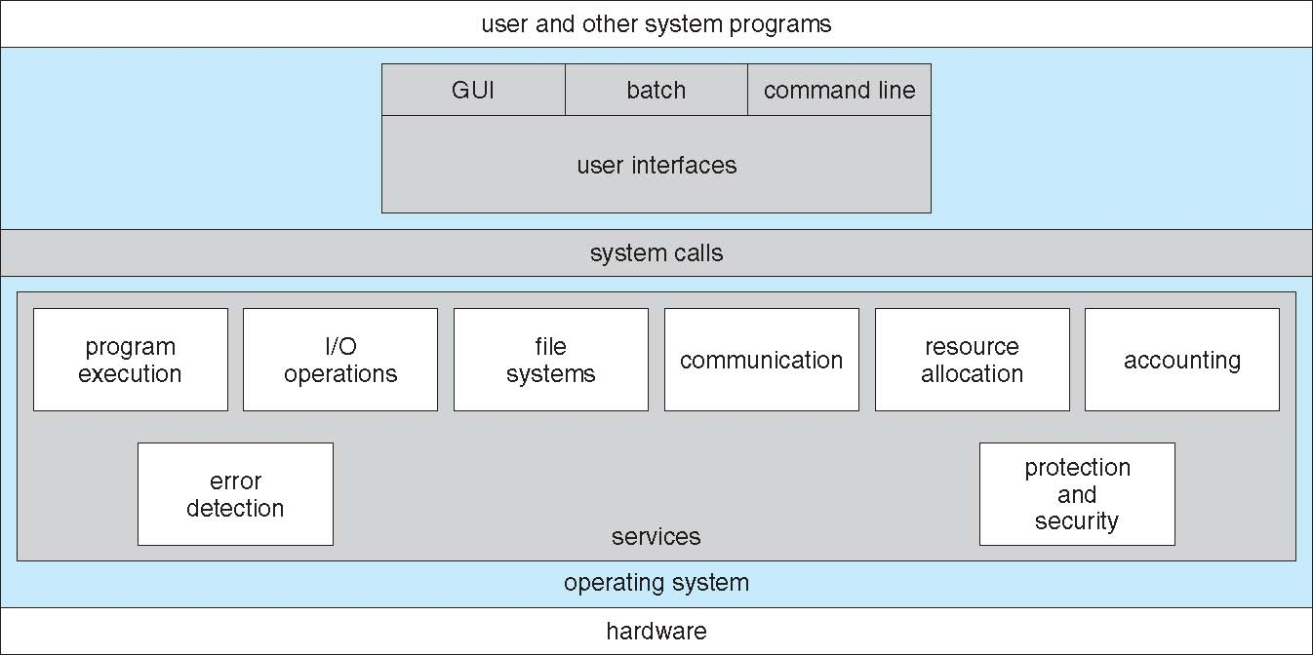
A View of Operating System Services
Prabhjot Chahal Operating System - 22CS005

Slide 7
User Operating System Interface - CLI
CLI or command interpreter allows direct command entry
Sometimes implemented in kernel, sometimes by systems program
Sometimes multiple flavors implemented – shells
Primarily fetches a command from user and executes it
Sometimes commands built-in, sometimes just names of programs
If the latter, adding new features doesn’t require shell modification
Prabhjot Chahal Operating System - 22CS005

Slide 8
System Calls
Programming interface to the services provided by the OS
Typically written in a high-level language (C or C++)
Mostly accessed by programs via a high-level Application Programming Interface (API) rather than direct system call use
Three most common APIs are Win32 API for Windows, POSIX API for POSIX-based systems (including virtually all versions of UNIX, Linux, and Mac OS X), and Java API for the Java virtual machine (JVM)
Prabhjot Chahal Operating System - 22CS005

Slide 9
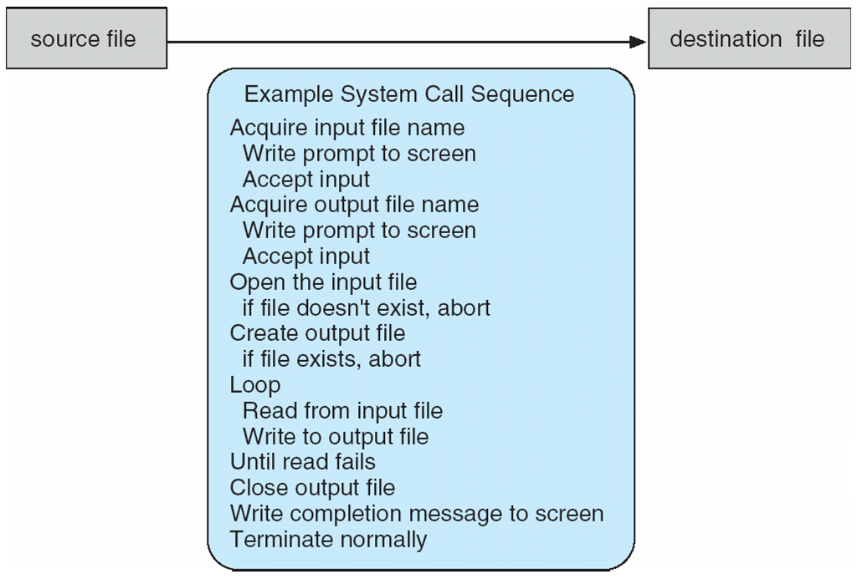
Example of System Calls
System call sequence to copy the contents of one file to another file
Prabhjot Chahal Operating System - 22CS005

Slide 10
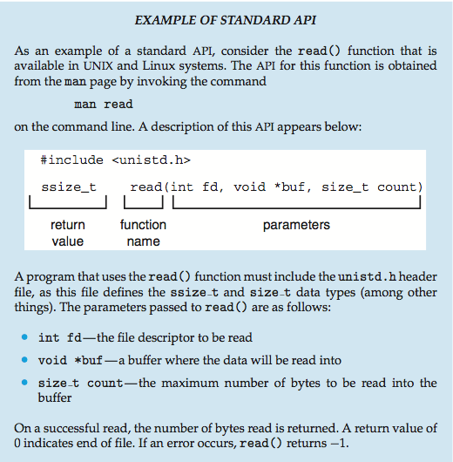
Example of Standard API
Prabhjot Chahal Operating System - 22CS005

Slide 11
System Call Implementation
Typically, a number associated with each system call
System-call interface maintains a table indexed according to these numbers
The system call interface invokes the intended system call in OS kernel and returns status of the system call and any return values
The caller need know nothing about how the system call is implemented
Just needs to obey API and understand what OS will do as a result call
Most details of OS interface hidden from programmer by API
Managed by run-time support library (set of functions built into libraries included with compiler)
Prabhjot Chahal Operating System - 22CS005

Slide 12
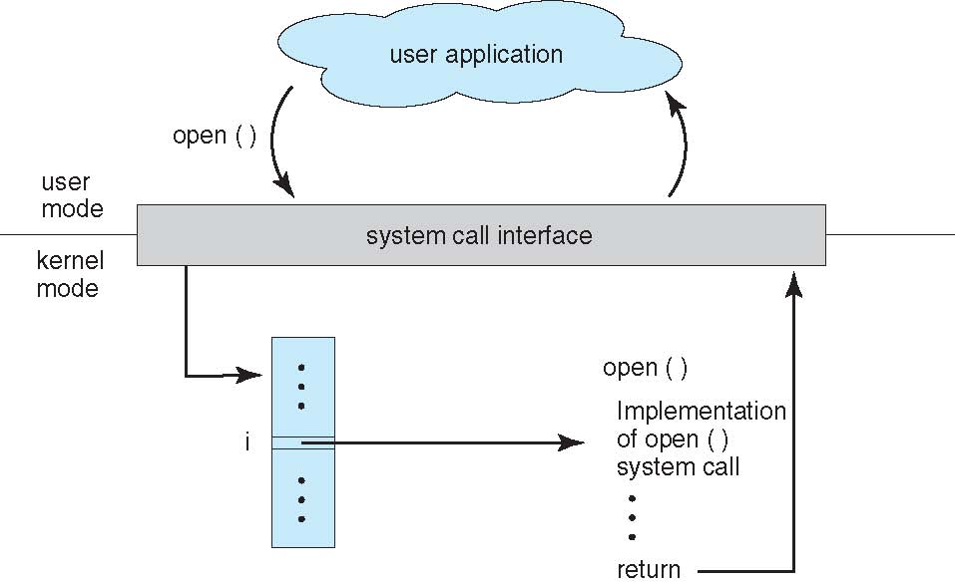
API – System Call – OS Relationship
Prabhjot Chahal Operating System - 22CS005

Slide 13
System Call Parameter Passing
Often, more information is required than simply identity of desired system call
Exact type and amount of information vary according to OS and call
Three general methods used to pass parameters to the OS
Simplest: pass the parameters in registers
In some cases, may be more parameters than registers
Parameters stored in a block, or table, in memory, and address of block passed as a parameter in a register
This approach taken by Linux and Solaris
Parameters placed, or pushed, onto the stack by the program and popped off the stack by the operating system
Block and stack methods do not limit the number or length of parameters being passed
Prabhjot Chahal Operating System - 22CS005

Slide 14
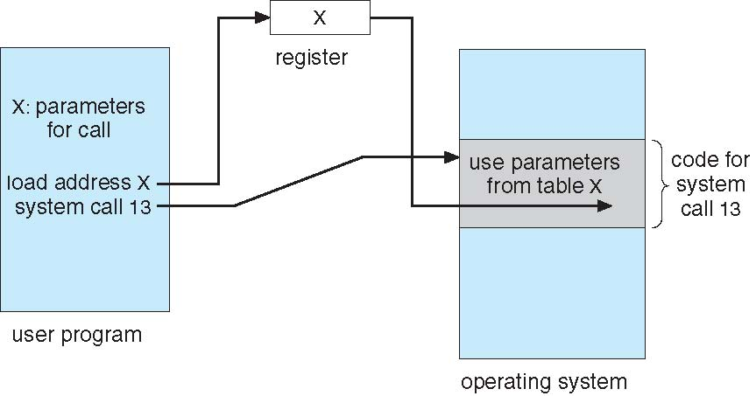
Parameter Passing via Table

Slide 15
Types of System Calls
Process control
create process, terminate process
end, abort
load, execute
get process attributes, set process attributes
wait for time
wait event, signal event
allocate and free memory
Dump memory if error
Debugger for determining bugs, single step execution
Locks for managing access to shared data between processes
File management
create file, delete file
open, close file
read, write, reposition
get and set file attributes
Prabhjot Chahal Operating System - 22CS005

Slide 16
Types of System Calls
Device management
request device, release device
read, write, reposition
get device attributes, set device attributes
logically attach or detach devices
Information maintenance
get time or date, set time or date
get system data, set system data
get and set process, file, or device attributes
Communications
create, delete communication connection
send, receive messages if message passing model to host name or process name
From client to server
Shared-memory model create and gain access to memory regions
transfer status information
attach and detach remote devices
Protection
Control access to resources
Get and set permissions
Allow and deny user access
Prabhjot Chahal Operating System - 22CS005

Slide 17
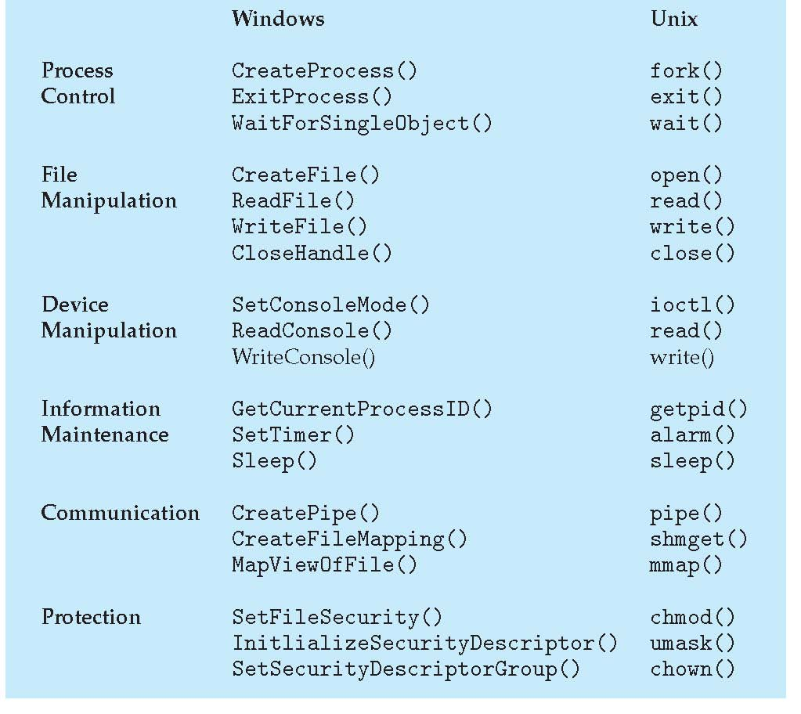
Prabhjot Chahal Operating System - 22CS005

Slide 18
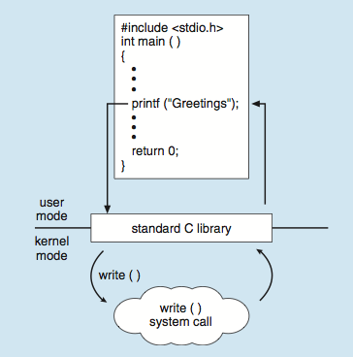
C program invoking printf() library call, which calls write() system call
Prabhjot Chahal Operating System - 22CS005

Slide 19
System Programs
System programs provide a convenient environment for program development and execution. They can be divided into:
File manipulation
Status information sometimes stored in a File modification
Programming language support
Program loading and execution
Communications
Background services
Application programs
Most users’ view of the operation system is defined by system programs, not the actual system calls
Prabhjot Chahal Operating System - 22CS005

Slide 20
System Programs
Provide a convenient environment for program development and execution
Some of them are simply user interfaces to system calls; others are considerably more complex
File management - Create, delete, copy, rename, print, dump, list, and generally manipulate files and directories
Status information
Some ask the system for info - date, time, amount of available memory, disk space, number of users
Others provide detailed performance, logging, and debugging information
Typically, these programs format and print the output to the terminal or other output devices
Some systems implement a registry - used to store and retrieve configuration information
Prabhjot Chahal Operating System - 22CS005

Slide 21
File modification
Text editors to create and modify files
Special commands to search contents of files or perform transformations of the text
Programming-language support - Compilers, assemblers, debuggers and interpreters sometimes provided
Program loading and execution- Absolute loaders, relocatable loaders, linkage editors, and overlay-loaders, debugging systems for higher-level and machine language
Communications - Provide the mechanism for creating virtual connections among processes, users, and computer systems
Allow users to send messages to one another’s screens, browse web pages, send electronic-mail messages, log in remotely, transfer files from one machine to another
Prabhjot Chahal Operating System - 22CS005

Slide 22
Background Services
Launch at boot time
Some for system startup, then terminate
Some from system boot to shutdown
Provide facilities like disk checking, process scheduling, error logging, printing
Run in user context not kernel context
Known as services, subsystems, daemons
Application programs
Don’t pertain to system
Run by users
Not typically considered part of OS
Launched by command line, mouse click, finger poke
Prabhjot Chahal Operating System - 22CS005

Slide 23
Thank You
Prabhjot Chahal Operating System - 22CS005

